Slide 1
LET’S BE READY,
LET’S BE EVERYWHERE,
LET’S BE A MAX!
SATURDAY, MARCH 18TH 2023 Data cleaning and second life of digital equipment
Name of the operation : ………………………………………….……………………………………………………….
Organiser(s) : …………………………………………………………….……………………………………………………….…………………….……
Meeting point : ………………………………………….……………………………………………………….
Contact(s) :
……………………… ………………………………..…….
Date/Time : ……………………… …………………………………….

Slide 2
LET’S BE READY,
LET’S BE EVERYWHERE,
LET’S BE A MAX!
SATURDAY, MARCH 18TH 2023 Data cleaning and second life of digital equipment
Name of the operation : ………………………………………….……………………………………………………….
Organiser(s) : …………………………………………………………….……………………………………………………….…………………….……
Meeting point : ………………………………………….……………………………………………………….
Contact(s) :
……………………… ………………………………..…….
Date/Time : ……………………… …………………………………….

Slide 3
LET’S BE READY,
LET’S BE EVERYWHERE,
LET’S BE A MAX!
SATURDAY, MARCH 18TH 2023 Data cleaning and second life of digital equipment
Name of the operation : ………………………………………….……………………………………………………….
Organiser(s) : …………………………………………………………….……………………………………………………….…………………….……
Meeting point : ………………………………………….……………………………………………………….
Contact(s) :
……………………… ………………………………..…….
Date/Time : ……………………… …………………………………….

Slide 4
LET’S BE READY,
LET’S BE EVERYWHERE,
LET’S BE A MAX!
SATURDAY, MARCH 18TH 2023 Data cleaning and second life of digital equipment
Name of the operation : ………………………………………….……………………………………………………….
Organiser(s) : …………………………………………………………….……………………………………………………….…………………….……
Meeting point : ………………………………………….……………………………………………………….
Contact(s) :
……………………… ………………………………..…….
Date/Time : ……………………… …………………………………….

Slide 5
LET’S BE READY,
LET’S BE EVERYWHERE,
LET’S BE A MAX!
SATURDAY, MARCH 18TH 2023 Data cleaning and second life of digital equipment
Name of the operation : ………………………………………….……………………………………………………….
Organiser(s) : …………………………………………………………….……………………………………………………….…………………….……
Meeting point : ………………………………………….……………………………………………………….
Contact(s) :
……………………… ………………………………..…….
Date/Time : ……………………… …………………………………….

Slide 6
LET’S BE READY,
LET’S BE EVERYWHERE,
LET’S BE A MAX!
SATURDAY, MARCH 18TH 2023 Data cleaning and second life of digital equipment
Name of the operation : ………………………………………….……………………………………………………….
Organiser(s) : …………………………………………………………….……………………………………………………….…………………….……
Meeting point : ………………………………………….……………………………………………………….
Contact(s) :
……………………… ………………………………..…….
Date/Time : ……………………… …………………………………….

Slide 7
LET’S BE READY,
LET’S BE EVERYWHERE,
LET’S BE A MAX!
SATURDAY, MARCH 18TH 2023 Data cleaning and second life of digital equipment
Name of the operation : ………………………………………….……………………………………………………….
Organiser(s) : …………………………………………………………….……………………………………………………….…………………….……
Meeting point : ………………………………………….……………………………………………………….
Contact(s) :
……………………… ………………………………..…….
Date/Time : ……………………… …………………………………….

Slide 8
LET’S BE READY,
LET’S BE EVERYWHERE,
LET’S BE A MAX!
SATURDAY, MARCH 18TH 2023 Data cleaning and second life of digital equipment
Name of the operation : ………………………………………….……………………………………………………….
Organiser(s) : …………………………………………………………….……………………………………………………….…………………….……
Meeting point : ………………………………………….……………………………………………………….
Contact(s) :
……………………… ………………………………..…….
Date/Time : ……………………… …………………………………….

Slide 9
LET’S BE READY,
LET’S BE EVERYWHERE,
LET’S BE A MAX!
SATURDAY, MARCH 18TH 2023 Data cleaning and second life of digital equipment
Name of the operation : ………………………………………….……………………………………………………….
Organiser(s) : …………………………………………………………….……………………………………………………….…………………….……
Meeting point : ………………………………………….……………………………………………………….
Contact(s) :
……………………… ………………………………..…….
Date/Time : ……………………… …………………………………….

Slide 10
LET’S BE READY,
LET’S BE EVERYWHERE,
LET’S BE A MAX!
SATURDAY, MARCH 18TH 2023 Data cleaning and second life of digital equipment
Name of the operation : ………………………………………….……………………………………………………….
Organiser(s) : …………………………………………………………….……………………………………………………….…………………….……
Meeting point : ………………………………………….……………………………………………………….
Contact(s) :
……………………… ………………………………..…….
Date/Time : ……………………… …………………………………….

Slide 11
LET’S BE READY,
LET’S BE EVERYWHERE,
LET’S BE A MAX!
SATURDAY, MARCH 18TH 2023 Data cleaning and second life of digital equipment
Name of the operation : ………………………………………….……………………………………………………….
Organiser(s) : …………………………………………………………….……………………………………………………….…………………….……
Meeting point : ………………………………………….……………………………………………………….
Contact(s) :
……………………… ………………………………..…….
Date/Time : ……………………… …………………………………….

Slide 12
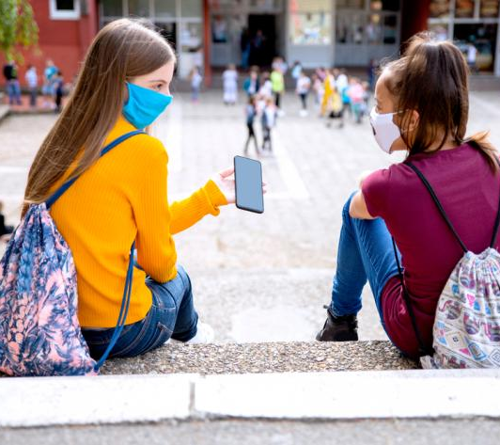
LET’S BE READY,
LET’S BE EVERYWHERE,
LET’S BE A MAX!
SATURDAY, MARCH 18TH 2023 Data cleaning and second life of digital equipment
Name of the operation : ………………………………………….……………………………………………………….
Organiser(s) : …………………………………………………………….……………………………………………………….…………………….……
Meeting point : ………………………………………….……………………………………………………….
Contact(s) :
……………………… ………………………………..…….
Date/Time : ……………………… …………………………………….

Slide 13
LET’S BE READY,
LET’S BE EVERYWHERE,
LET’S BE A MAX!
SATURDAY, MARCH 18TH 2023 Data cleaning and second life of digital equipment
Name of the operation : ………………………………………….……………………………………………………….
Organiser(s) : …………………………………………………………….……………………………………………………….…………………….……
Meeting point : ………………………………………….……………………………………………………….
Contact(s) :
……………………… ………………………………..…….
Date/Time : ……………………… …………………………………….

Slide 14
LET’S BE READY,
LET’S BE EVERYWHERE,
LET’S BE A MAX!
SATURDAY, MARCH 18TH 2023 Data cleaning and second life of digital equipment
Name of the operation : ………………………………………….……………………………………………………….
Organiser(s) : …………………………………………………………….……………………………………………………….…………………….……
Meeting point : ………………………………………….……………………………………………………….
Contact(s) :
……………………… ………………………………..…….
Date/Time : ……………………… …………………………………….

